Slide 1


Lecture 6: Clustering and Segmentation
Harbin Institute of Technology（Shenzhen）
Jingyong Su
sujingyong@hit.edu.cn

Slide 2
Outline
Introduction
Clustering
Agglomerative
K-Means
Mean-Shift

Slide 3
Image Segmentation
• Goal: identify groups of pixels that go together

Slide 4
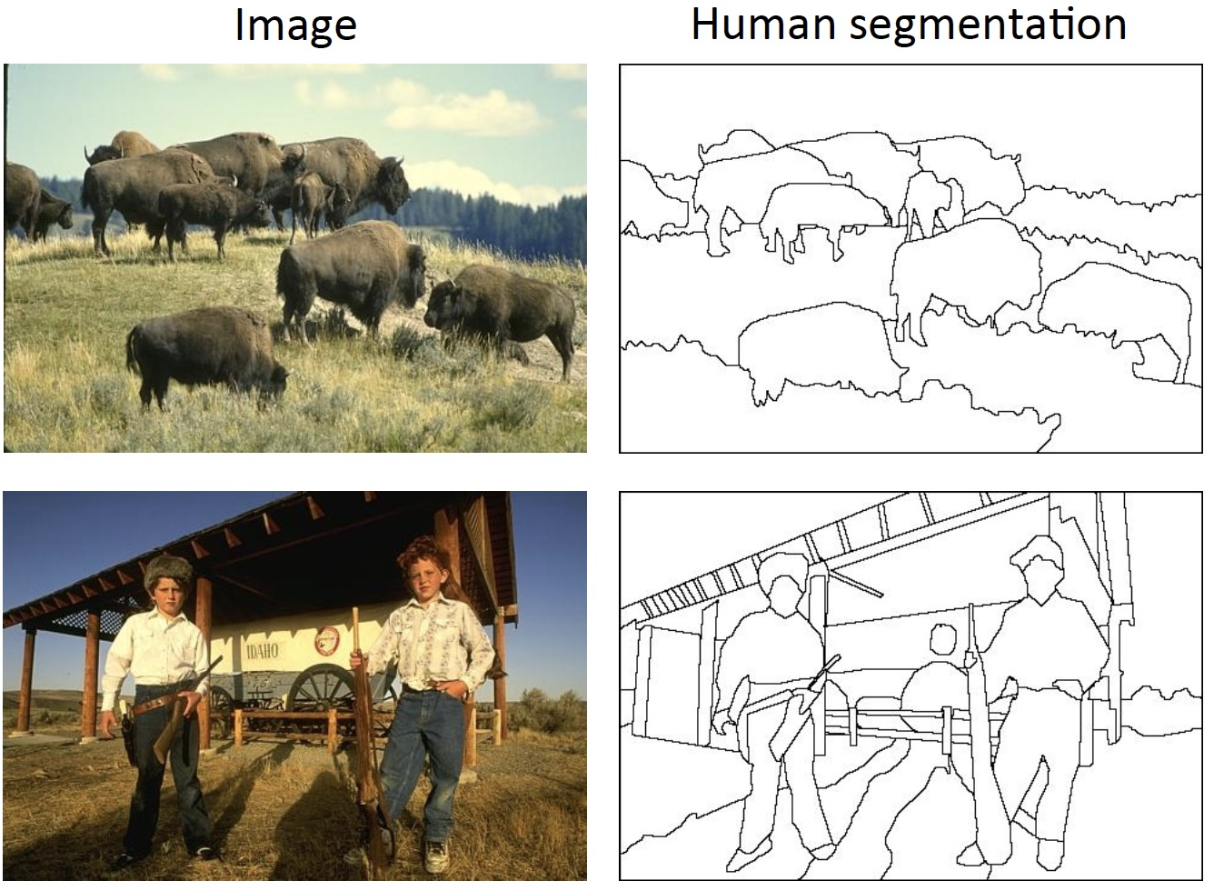
Image Segmentation
• Separate image into coherent “objects”

Slide 5
The Goals of Segmentation
• Separate image into coherent “objects”
• Group together similar-looking pixels for efficiency of further processing
“Superpixels”

Slide 6
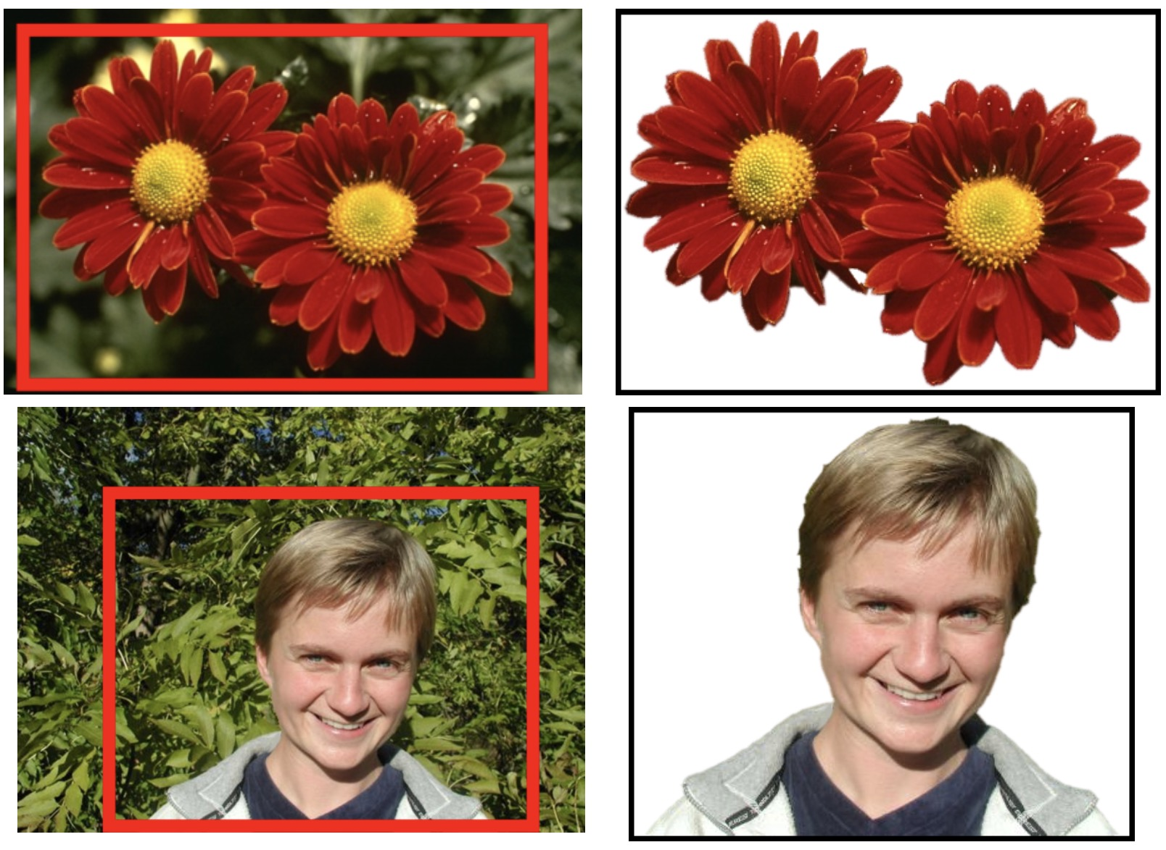
Segmentation as a Result

Slide 7
Segmentation as Clustering
• Clustering: group together similar points and represent them with a single token
Key challenges:
What makes two points/patches/images similar?
How do we compute an overall grouping from pairwise similarities?

Slide 8
How Do We Cluster?
• Agglomerative clustering
– Start with each point as its own cluster and iteratively merge the closest clusters
• K-means
– Iteratively re-assign points to the nearest cluster center
• Mean-shift clustering
– Estimate modes of pdf

Slide 9
General Ideas
• Tokens
– whatever we need to group (pixels, points, surface elements, etc.)
• Bottom up clustering
– tokens belong together because they are locally coherent
• Top down clustering
– tokens belong together because they lie on the same visual entity (object, scene…)
>These two are not mutually exclusive

Slide 10
Outline
Introduction
Clustering
Agglomerative
K-Means
Mean-Shift

Slide 11
Agglomerative Clustering
Clustering is an unsupervised learning method.
Given , the goal is to group them into clusters.
The general idea behind agglomerative clustering is to look at similarities between points to decide how these points should be grouped in a sensible manner.
We need a pairwise distance/similarity function.
Euclidean distance
Cosine similarity
Etc.

Slide 12
Agglomerative Clustering

Slide 13
Agglomerative Clustering

Slide 14
Agglomerative Clustering

Slide 15
Agglomerative Clustering

Slide 16
Agglomerative Clustering

Slide 17
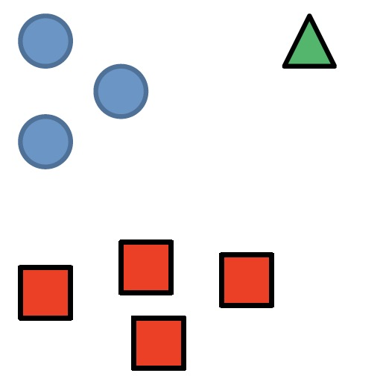
Agglomerative Clustering
How to define cluster similarity?
Average distance between points,
Maximum distance (complete-linkage)
Minimum distance (single-linkage)
Distance between means or medoids
How many clusters?
Clustering creates a dendrogram (a tree)
Threshold based on max number of clusters or based on distance between merges

Slide 18
Agglomerative Clustering
Algorithm
1. Initialize each point as its own cluster
2. Find the most similar pair of clusters
3. Merge the similar pair of clusters into a parent cluster
4. Repeat steps 2 & 3 until we have only 1 cluster.

Slide 19
Agglomerative Clustering
Good
• Simple to implement, widespread applications
• Clusters have adaptive shapes
• Provides a hierarchy of clusters
Bad
• May have imbalanced clusters
• Still have to choose number of clusters or threshold
• Need to use an “ultrametric” to get a meaningful hierarchy

Slide 20
Outline
Introduction
Clustering
Agglomerative
K-Means
Mean-Shift

Slide 21
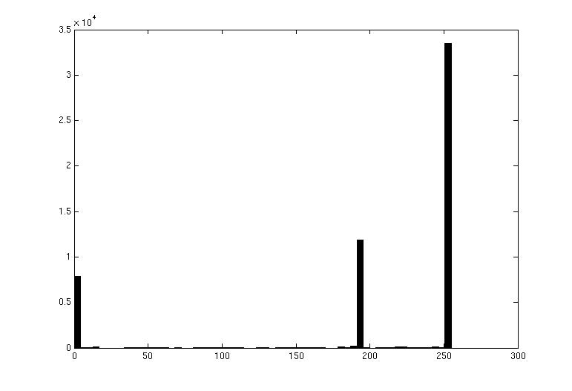

Image Segmentation: Toy Example
white pixels
3
black pixels
gray pixels
1
2
input image
intensity
These intensities deﬁne the three groups.
We could label every pixel in the image according to which of these primary intensities it is.
– i.e., segment the image based on the intensity feature.
What if the image isn’t quite so simple?

Slide 22
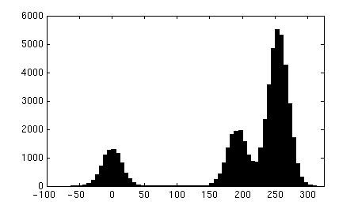
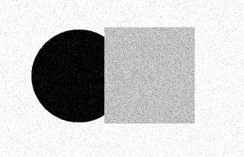
Input image
Pixel count
Intensity
Pixel count
Input image
Intensity

Slide 23
Input image
Pixel count
Intensity
Now how to determine the three main intensities that deﬁne our groups?
We need to cluster.

Slide 24
0
190
Intensity
255
3
1
2
Goal: choose three “centers” as the representative intensities and label every pixel according to which of these centers it is nearest to.
Best cluster centers are those that minimize Sum of Square Distance (SSD) between all points and their nearest cluster center c_{i}:
SSD = ∑
∑
(x − c_{i} )
2
Cluster i x∈cluster i

Slide 25
Clustering for Summarization
Goal: cluster to minimize variance in data given clusters
– Preserve information
Cluster center Data
1
N K
∑∑ ( )
2
c , δ = argmin
c, δ N
δ c − x
*
*
ij i j
j i
Whether x_{j} is assigned to c_{i}

Slide 26
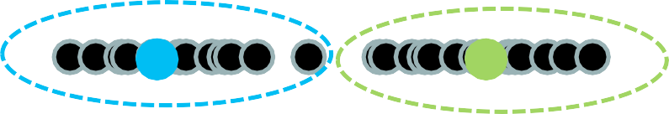
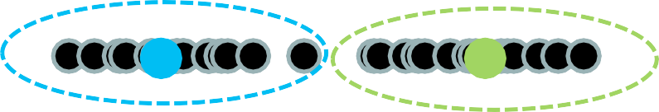
Clustering
With this objective, it is a “chicken and egg” problem:
– If we knew the cluster centers, we could allocate points to groups by assigning each to its closest center.
– If we knew the group memberships, we could get the centers by computing the mean per group.

Slide 27
K-Means Clustering
Initialize (t = 0 ): cluster centers c₁,..., c_{K}
Compute δ ^{t} : assign each point to the closest center
–
_{δ}t
denotes the set of assignment for each x_{j} to cluster c_{i} at iteration t
1
N
N K
∑∑
j i
δ c − x )
δ^{t} = argmin
δ
(
2
t−1 t−1
ij
i j
3. Computer c^{t}: update cluster centers as the mean of the points
1
N
N K
∑∑
j i
δ c − x )
(
2
c^{t} = argmin
c
t t−1
ij i
j
4. Update t = t +1 , Repeat Step 2-­‐3 till stopped

Slide 28
K-Means Clustering
Initialize (t = 0 ): cluster centers c₁,..., c_{K}
Commonly used: random initialization
Or greedily choose K to minimize residual
Compute δ ^{t} : assign each point to the closest center
Typical distance measure:
Euclidean
Cosine
Others
3. Computer c^{t}: update cluster centers as the mean of the points
1
N
N K
∑∑
j i
δ c − x )
(
2
c^{t} = argmin
c
t t−1
ij i
j
Update t = t +1 , Repeat Step 2-­‐3 till stopped
c^{t} doesn’t change anymore.

Slide 29
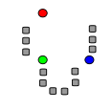
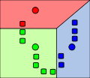
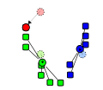
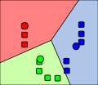
K-Means Clustering
1. Initialize Cluster Centers
2. Assign Points to Clusters
3. Re-compute Means
Repeat (2) and (3)

Slide 30
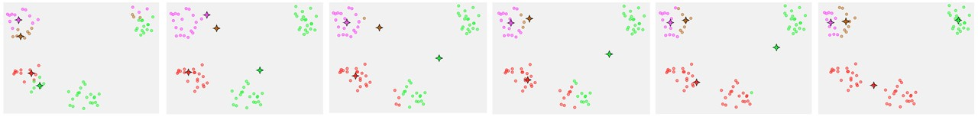
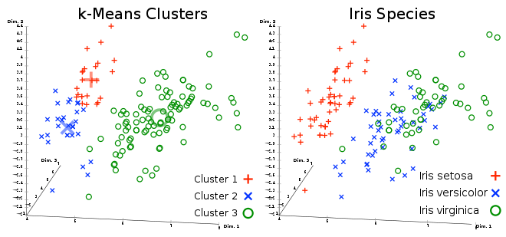
K-Means Clustering
Converges to a local minimum solution
– Initialize multiple runs
Better ﬁt for spherical data
Need to pick K (# of clusters)

Slide 31
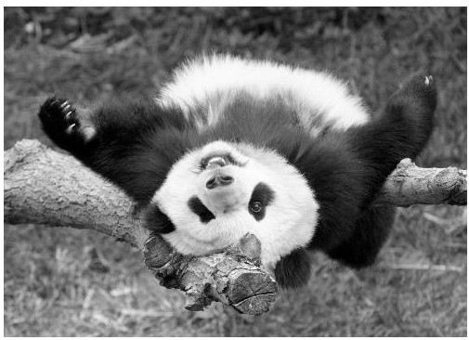
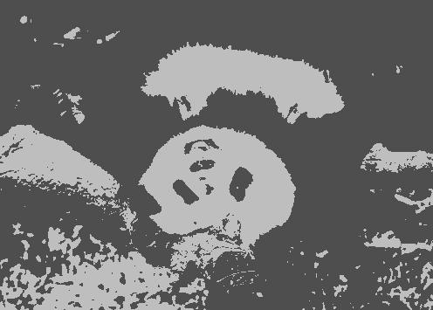
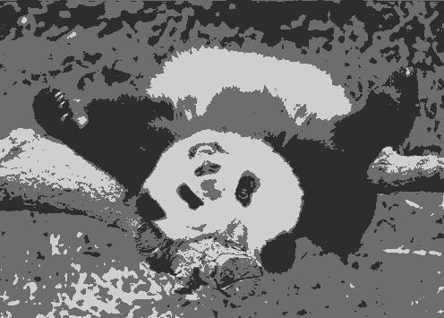
Segmentation as Clustering
K=2
K=3

Slide 32
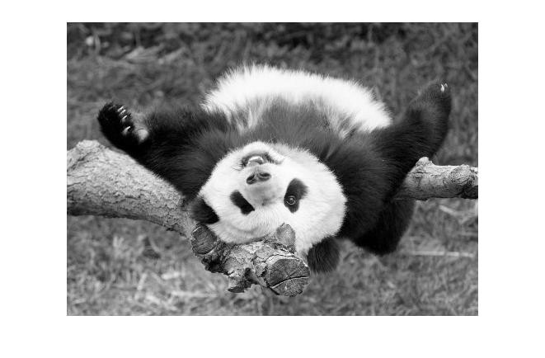
Feature Space
Depending on what we choose as the feature space, we can group pixels in diﬀerent ways.
Grouping pixels based on intensity similarity
Feature space: intensity value (1D)

Slide 33
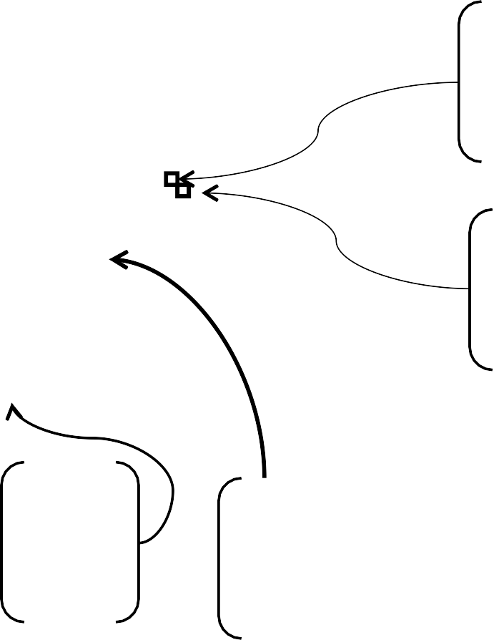
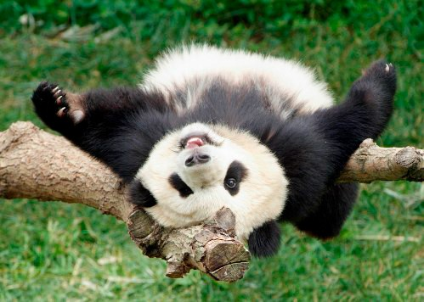
Feature Space
Depending on what we choose as the feature space, we can group pixels in diﬀerent ways.
Grouping pixels based on color similarity
R=255 G=200 B=250
B
R=245 G=220 B=248
G
R
R=15 G=189 B=2
R=3 G=12 B=2
Feature space: color value (3D)

Slide 34
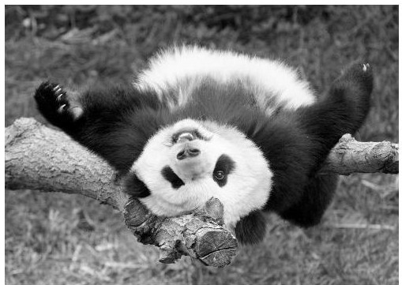
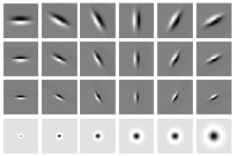
Feature Space
Depending on what we choose as the feature space, we can group pixels in diﬀerent ways.
Grouping pixels based on texture similarity
F₁
F₂
Filter bank of 24 ﬁlters
…
^{F}24
Feature space: ﬁlter bank responses (e.g., 24D)

Slide 35

Smoothing Out Cluster Assignments
Assigning a cluster label per pixel may yield outliers:
Original
Labeled by cluster center’s intensity
?
3
How can we ensure they are spatially smooth?
1
2

Slide 36
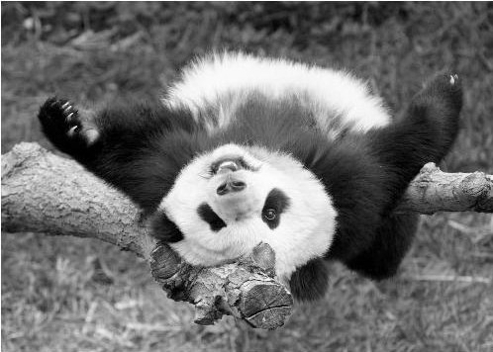
Segmentation as Clustering
Depending on what we choose as the feature space, we can group pixels in diﬀerent ways.
Grouping pixels based on
intensity+position similarity
Intensity
Y
X
Way to encode both similarity and proximity.

Slide 37
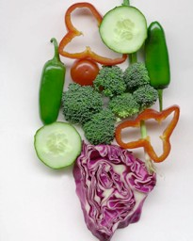
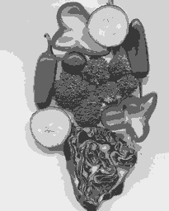
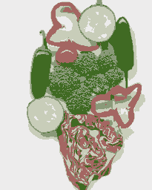
K-Means Clustering Results
K-means clustering based on intensity or color is essentially vector quantization of the image amributes
– Clusters don’t have to be spatially coherent
Image Intensity-­‐based clusters Color-­‐based clusters

Slide 38

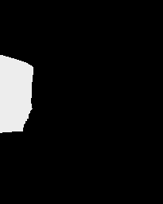



K-Means Clustering Results
K--means clustering based on intensity or color is essentially vector quantization of the image amributes
– Clusters don’t have to be spatially coherent
Clustering based on (r,g,b,x,y) values enforces more spatial coherence

Slide 39
How to evaluate clusters?
Generative
How well are points reconstructed from the clusters?
Discriminative
How well do the clusters correspond to labels?
Purity
Note: unsupervised clustering does not aim to be discriminative

Slide 40
How to choose the number of clusters?
Validation set
Try diﬀerent numbers of clusters and look at performance
When building dictionaries (discussed later), more clusters typically work better

Slide 41
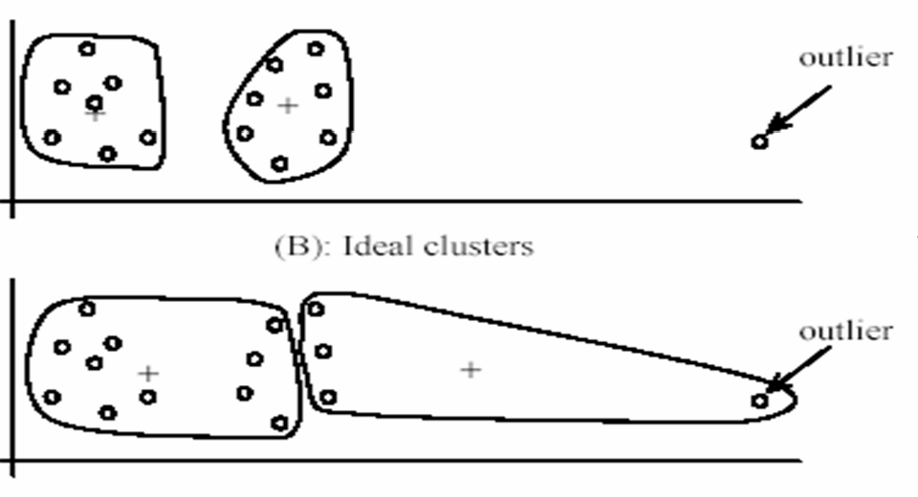
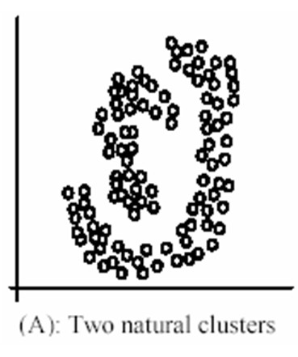
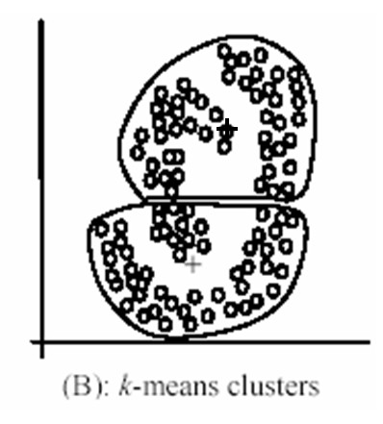
K-Means Pros and Cons
Pros
Finds cluster centers that minimize conditional variance (good representation of data)
Simple and fast, Easy to implement
Cons
Need to choose K
Sensitive to outliers
Prone to local minima
All clusters have the same parameters (e.g., distance measure is non-­‐ adaptive)
*Can be slow: each iteration is O(KNd) for N d-­‐dimensional points
Usage
Unsupervised clustering
Rarely used for pixel segmentation

Slide 42
Outline
Introduction
Clustering
Agglomerative
K-Means
Mean-Shift

